Slide 1
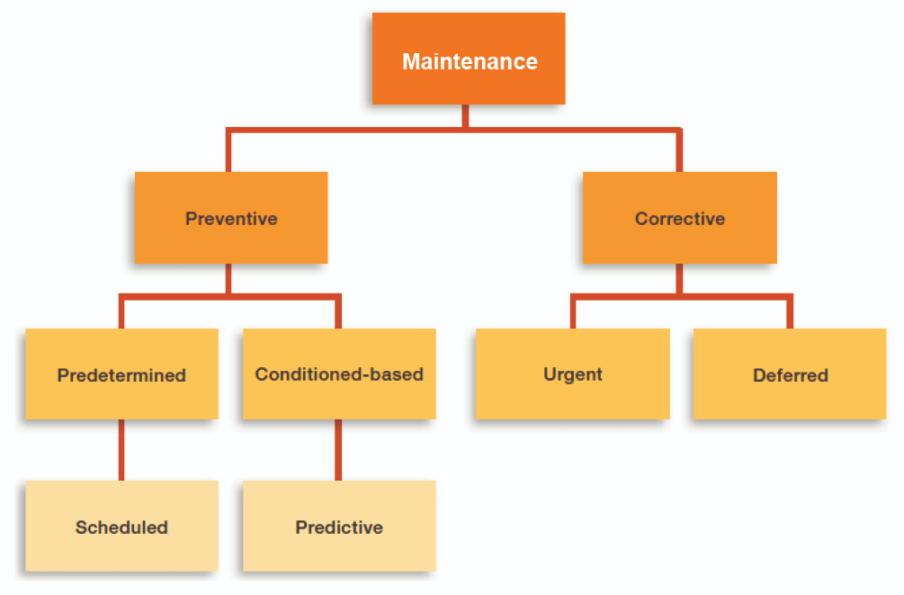
Re-cap from Lecture-1
Reliability,
Availability,
Maintainability,
Testability/ Inspectability
System Dynamics
Estimation
Fault Detection & Diagnostics

Slide 2
Re-cap from Lecture-2
Safety System Design
Fault Tolerant Design
Safety Systems
Rugged Design
Fail Safe
Design
Redundancy
Reliability Models/ PSA
Single Failure Criteria
Physical
Diversity
Analytical
Estimation/Fault Diagnostics/ Predictive Maintenance

Slide 3
Re-cap from Lecture-5
Estimation Techniques for Internal Variables
Sequential Monte Carlo for Non-Linear, Non-Gaussian Systems
Missing Data, Big-Data Analysis, Digital Twins
Fault Detection & Diagnosis/Isolation/
State Space Models, MIMO Systems
Simulation Models of SSEs ( Static & Dynamic Models)
Tweaking of Parameters & Variables in SSE Models
Simulation of Transient & Steady-state Characteristics of SSEs
Statistical Models for System Uncertainties & Measurement Noise
Fault Tree Analysis (Reliability Models, Failure Models, Test-data)
Selected Measurements at Specific Nodes of SSE
Signatures of Output Signals (Graphical, Spectral, etc.)
Preliminary Statistical Relations (Mean, Variance, Correlation, etc.)
System Dynamics, ODEs/PDEs, Transfer Function, Time & Freq. Domain
Parameters, Internal Variables, Measured Variables, Disturbances,
Maintenance Methodologies/ Paradigms
Digraphs/Records/Performance Charts/Manual Data Processing
Preliminary Analytic Tools/ Non-Parametric System Identification from Data

Slide 4
Lecture-12 -- Reliability Models
Procedure based Maint. Practices; Failure models; Concept of Reliability, Availability,
Maintainability, Inspectability/Testability (RAMI)
Reliability N/W; Series/Parallel N/W
m out of n Systems
Standby Systems
Fault Trees
Concept of Reliability & Failure Probability
Distribution Functions & Density Functions
Exponential Distribution/Density Functions
Normal/Gaussian
Log-Normal
Weibull
Poisson
Binomial
Failure Rate Function
Hazard Rate Function
General Reliability Functions
MTTF, MTTR, MTBF
Accelerated Testing
Arrhenius & Eyrring Models
Warranty by Manufacturer
Need for Maintenance
Sys./Eqpt. in Engg. Industrial Units
Pumps, Hex, Control-Valves, Actuators, Inst.
Process Loops
Time /Usage based Reliability Degradation
Applicability of Density Function Types
Physics of Failures Models for Sys./Eqpt.
N/W & Fault-Tree Configuration for Reliability Computation

Slide 5
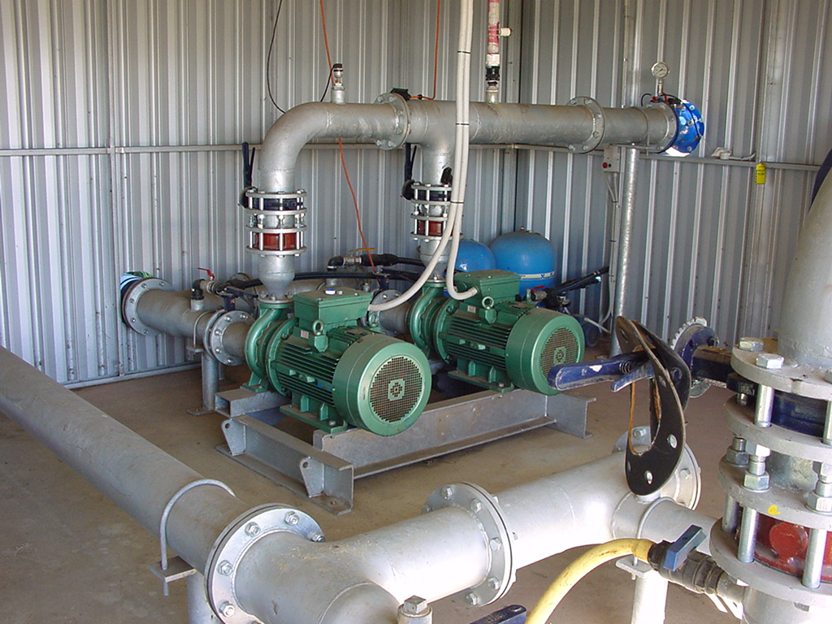
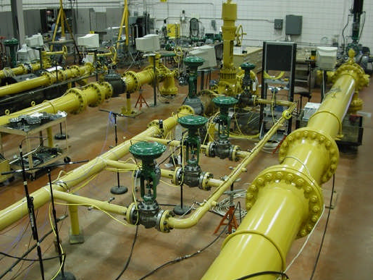
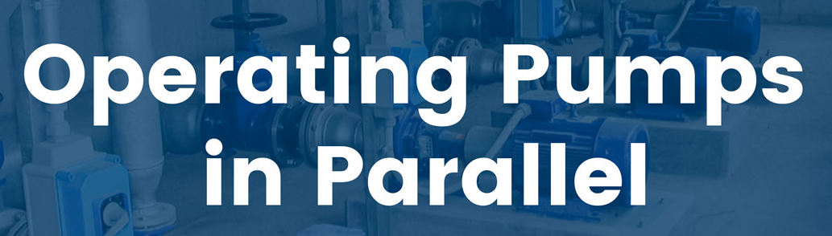
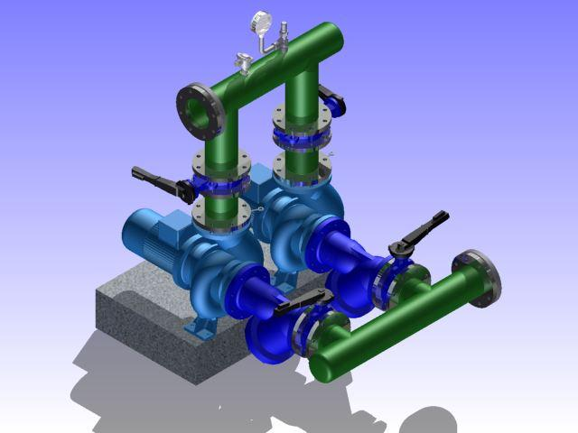
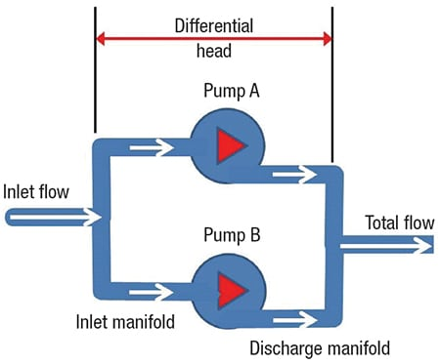
Control Valves in Parallel

Slide 6
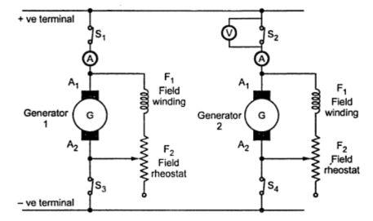
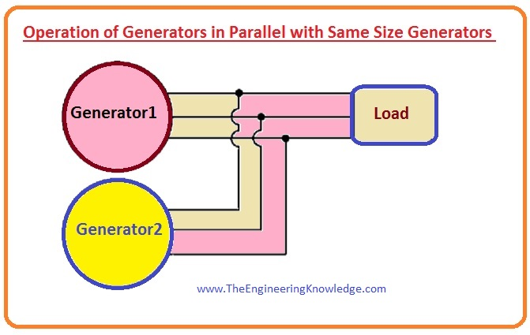
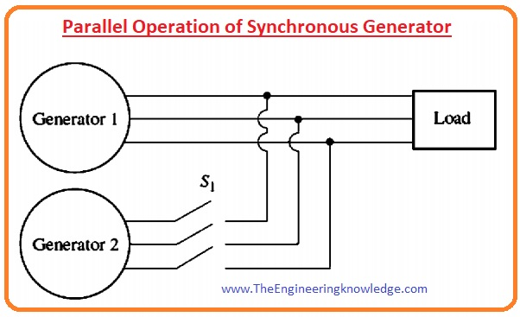
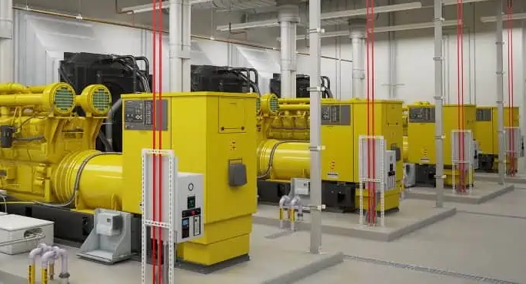
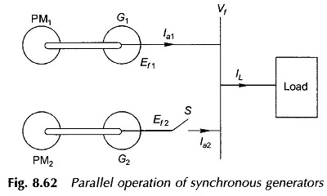
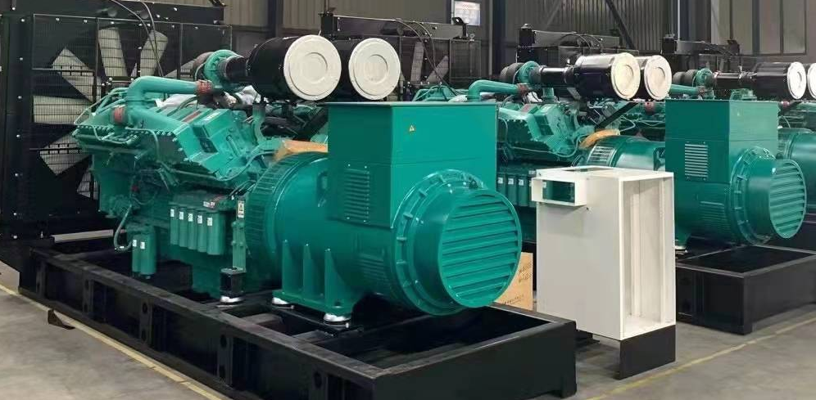
Paralleling of Generators

Slide 7
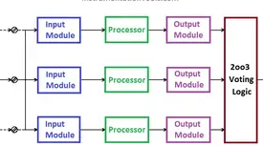
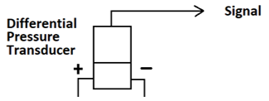
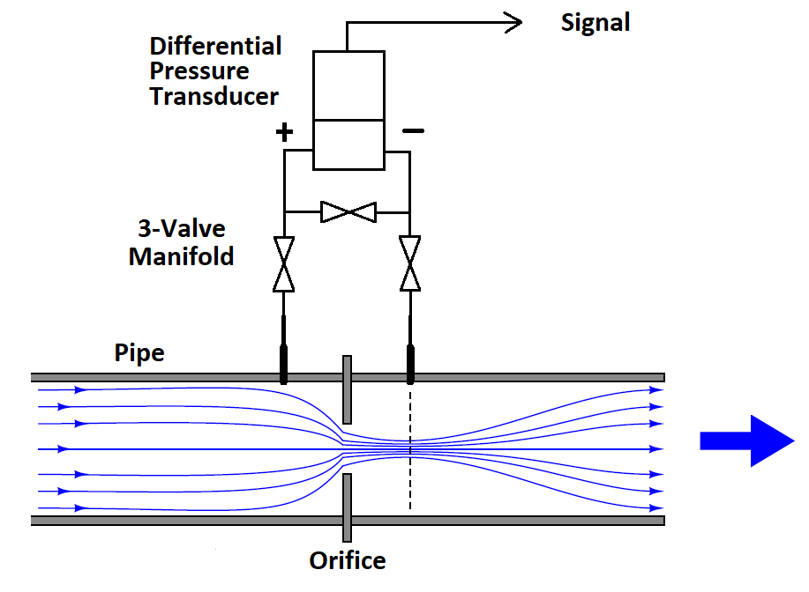
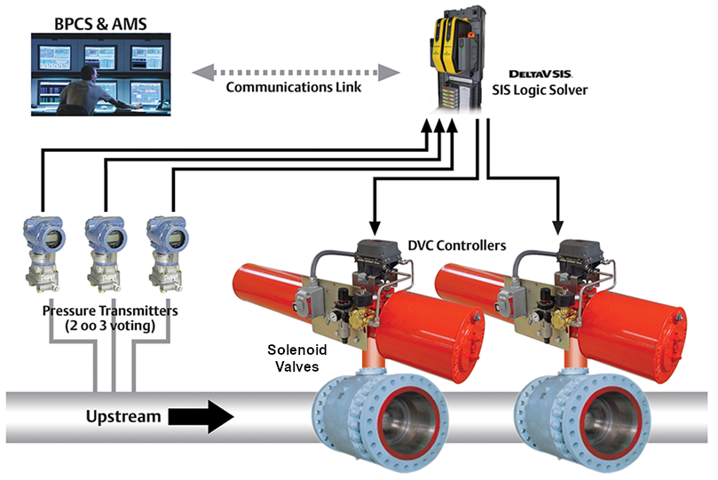
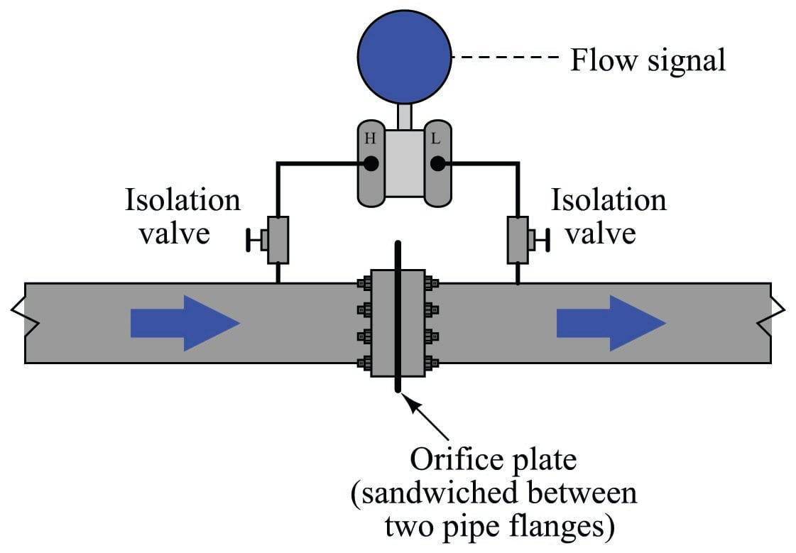
Redundancy in Instrumentation Systems

Slide 8
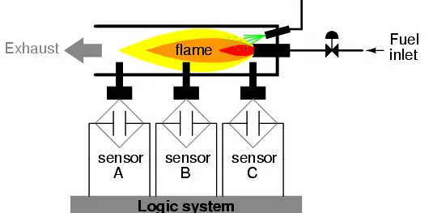
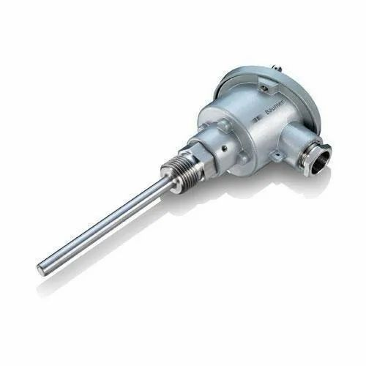
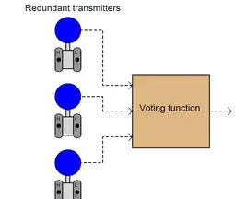
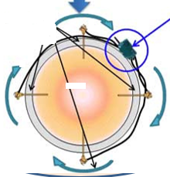
Redundant Temperature Sensors

Slide 9
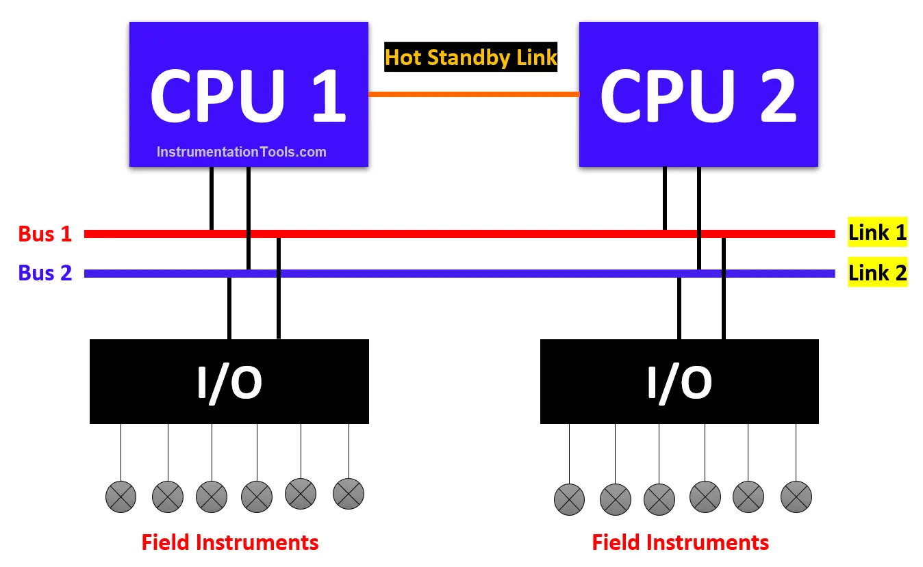
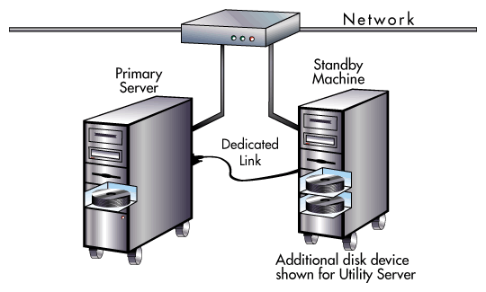
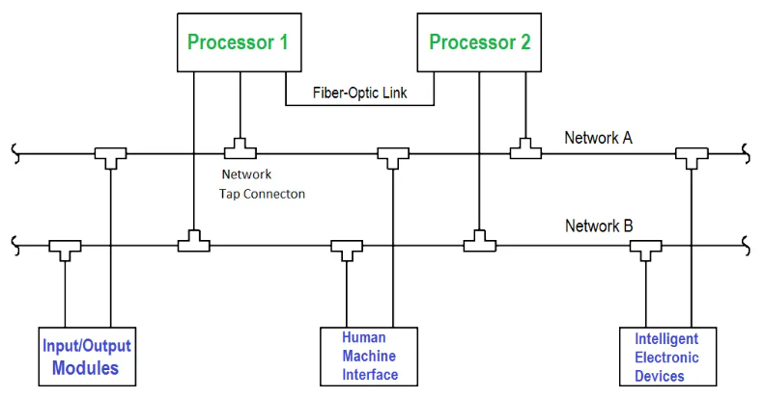
Dual Computer Hot Standby

Slide 10
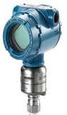
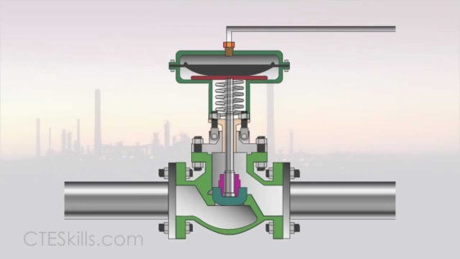
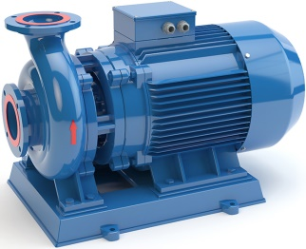
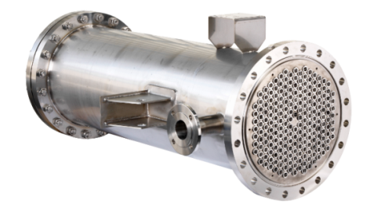
Pressure Measurement
Pneumatic Signal
Header
Control Valves
Heat Source
Surge Tank
Discharge
Suction
Pumps
Redundancy of Process Equipment
Heat Exchangers
Secy. Flow
Primary Flow
Reliability of Loop Operation

Slide 11
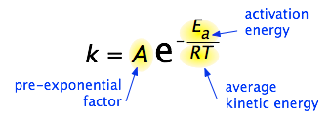
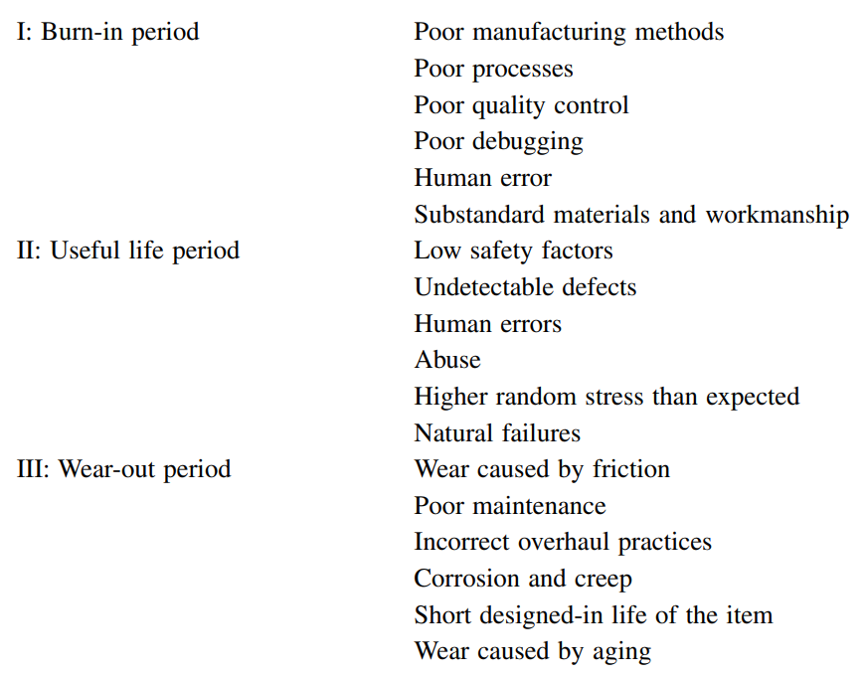
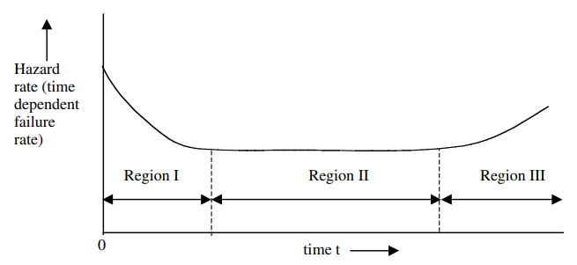
Arrhenius Equation
Reliability Engineering Concepts
The Bath-Tub Curve

Slide 12
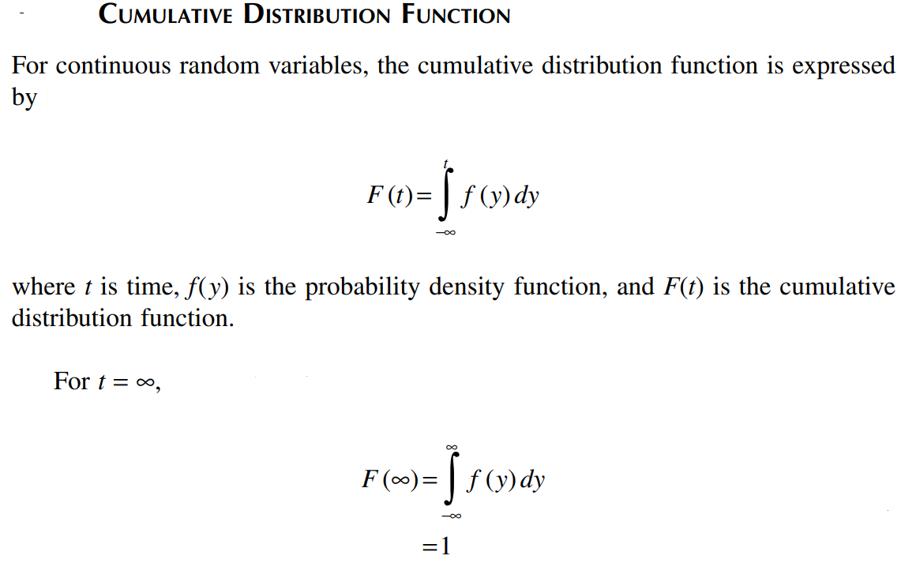

Slide 13
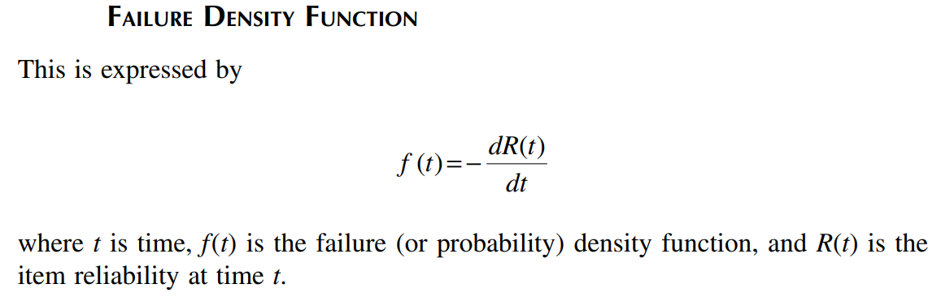
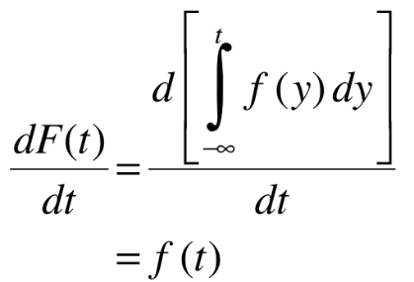
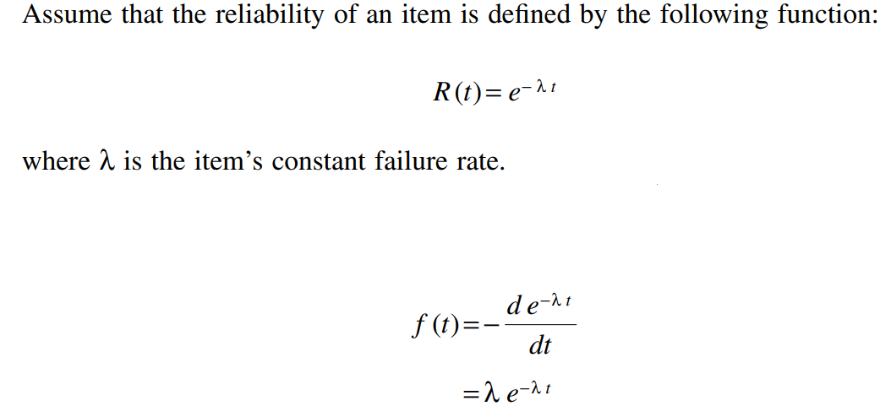
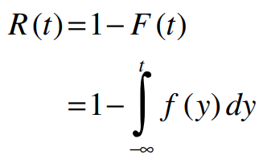
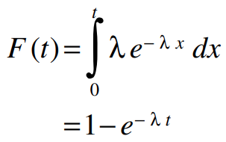
General Reliability Analysis Formulations -- 1
f(y) is the failure density function
R(t) is the reliability function
Failure Probability Distribution Function

Slide 14
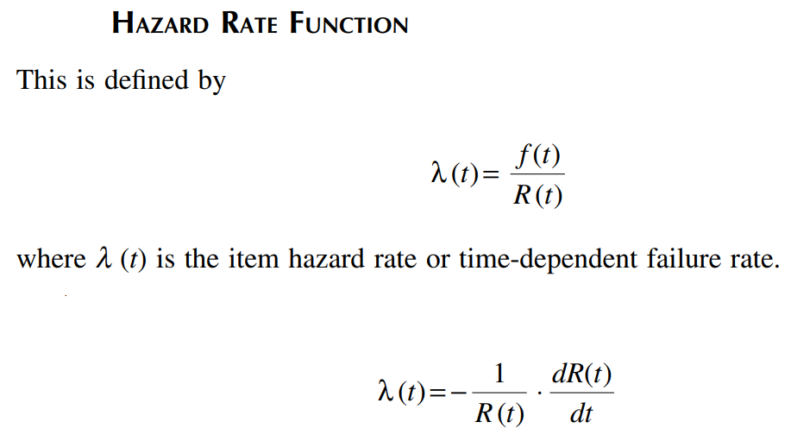
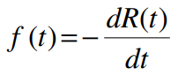
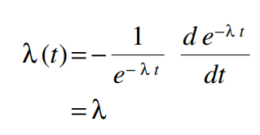
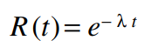
General Reliability Analysis Formulations -- 2

Slide 15
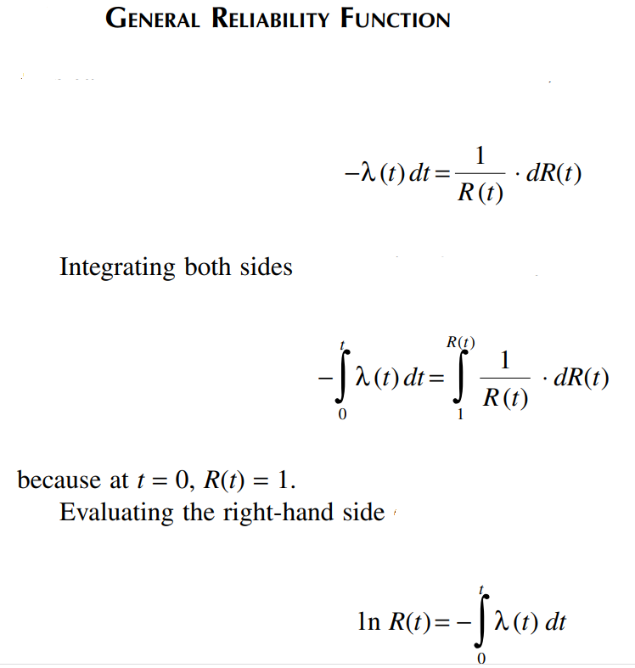
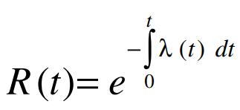
General Reliability Analysis Formulations -- 3

Slide 16
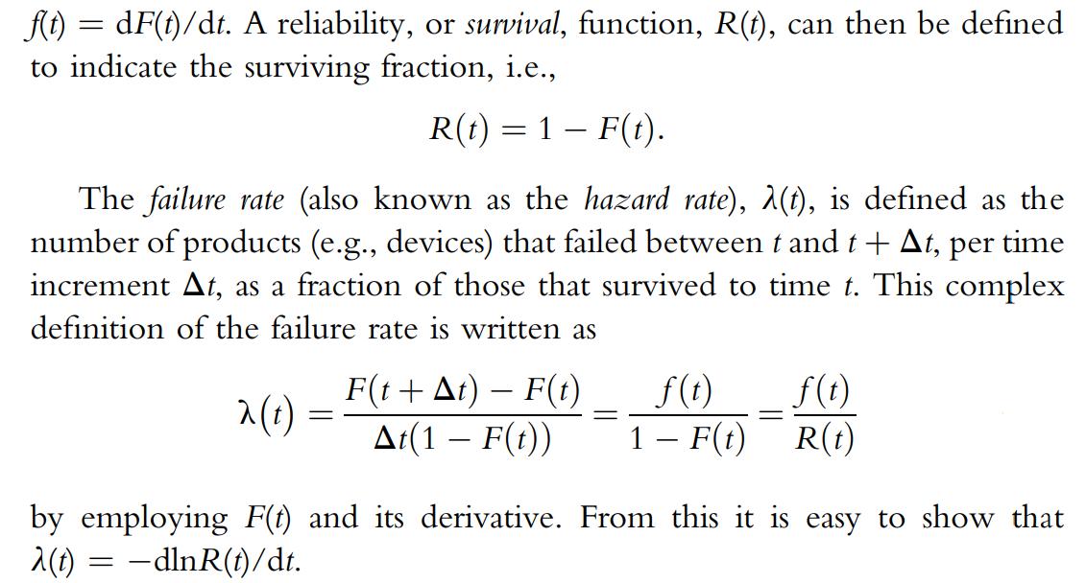
Some Understanding of the General Formulations

Slide 17
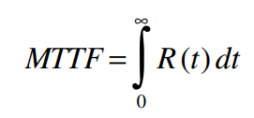
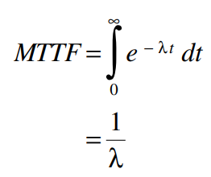
Mean Time to Fail (MTTF)/ Mean Time Between Failures (MTBF)
Mean time between failures (MTBF)
Prediction of the time between the failures of a piece of machinery;
During normal operating hours.
MTBF is a maintenance metric,
Represented in hours,
How long a piece of equipment operates without interruption.
MTBF is only used for repairable items
Planning for Equipment Repair.

Slide 18
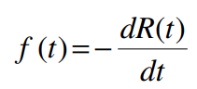
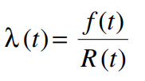
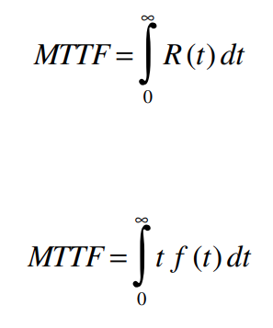
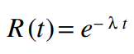





Summarizing the General Reliability Analysis Formulations
Failure Density Function
Hazard Rate Function
Mean Time to Failure
Reliability Function
λ is the item’s constant failure rate

Slide 19







Series Reliability

Slide 20







Parallel Reliability

Slide 21






Slide 22


Poisson Distribution
A Poisson Distribution is a discrete probability distribution
Gives probability of a discrete outcome
The discrete outcome is the number of times an event occurs, represented by k
Predict the number of events occurring within a given interval of time
Individual events happen at random and independently
The probability of one event doesn’t affect the probability of another event
Know the mean number of events occurring within a given interval of time;
This number is called λ and is assumed to be constant.
Define an “event”;
Specify the time interval;
Mean number of events per time interval, λ;
Number of events in a specific time interval is k;
One parameter, λ, which is the mean no. of events.

Slide 23




Some of the Common Probability Distributions, for Reliability Formulations
Normal Distribution
Log Normal Distribution
Weibull Distribution
Binomial Distribution

Slide 24


Essentially for Electronic Components

Slide 25



Summarizing --- Failure Probability Distribution Function

Slide 26

Building Fault Tree Models

Slide 27




Building Fault Tree Models

Slide 28




Slide 29
Common Cause Failures

Slide 30

Preventive Maintenance
Equipment Failure Data
Component Failure Data
MTBF Formulations
PM at Routine Intervals
A Predictive Maintenance Approach
System /Equipment
Decision to Carry out Maintenance.
Input from Process
Dynamic Model of System /Equipment
Estimation of Variables /FDD

